Slide 1
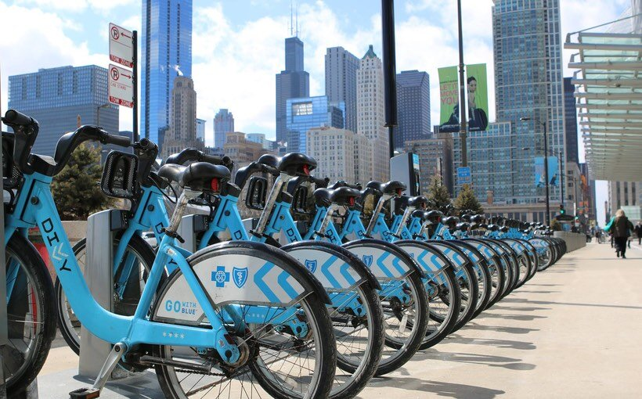
Divvy Van Navigator
By: Andy Hansana, Kevin Elliott, Ryan Crowley, Vincent Weaver

Slide 2
Overview - Divvy Van Navigator
The Divvy Van Navigator is an application used to assist with Divvy maintenance drivers on their daily pathing of repairs and replacements
This app will be used in the van to help navigate throughout Chicago to each divvy station, taking them on the most efficient path.
This app is designed to be used by Divvy employees.

Slide 3
Overview - Code and Algorithms
Divvy station location data pulled from Divvy API using Unirest.
Uses Greedy Algorithm to optimize the path from each Divvy station.
Drivers are able to pick up bikes from each station if they are low to allow for maintenance at any stop, regardless of the next stations stock.
The map used in this application is a webview of Google Maps which is used for navigation between Divvy stations and viewing current location.

Slide 4
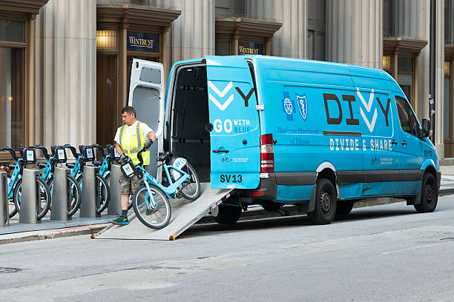
What Will the Program do for them?
The Divvy Van Navigator will show the driver specific information about each Divvy station such as the amount of bikes and scooters at each station, and the best path to get there.
The map provides the driver with specific traffic delays such as any car accidents, construction in any area, and delays that will impact the drivers arrive time to each station.
This application also provides the driver with all the divvy stations, and has button features for the driver to mark a stop as completed, and updating bikes/scooters in the van.

Slide 5


Why Our Product?
Our product will benefit Divvy drivers for specific purposes such as efficiency , and reliability.
With further funding into this prototype, divvy drivers will have an all in one application to fulfill their needs for supplying and fixing stops for bikes and scooters.
Furthermore, this application will be able to branch out into more subcategories with Lyft operating the Divvy system in Chicago.
Branching out to Lyft drivers and more.

Slide 6

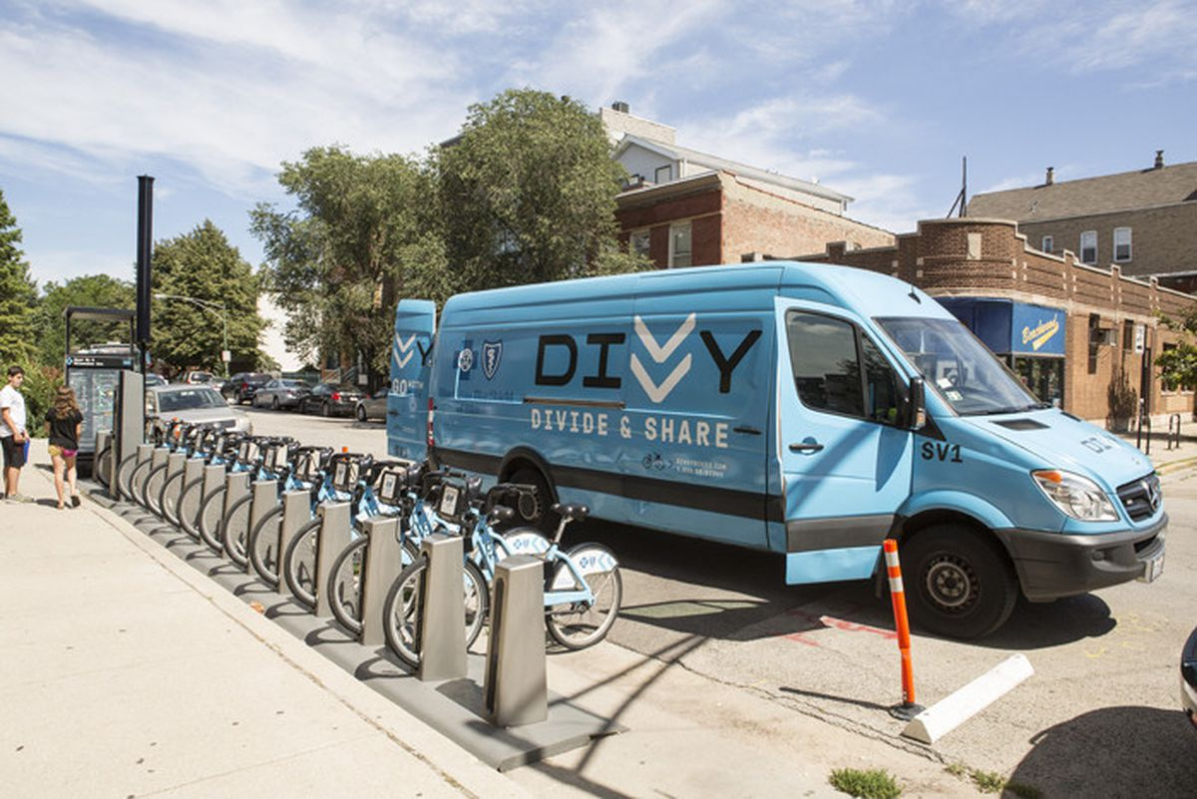
Long Term Benefits of this Product
Easier time navigating stations through Chicago
Automation of Station order and pathing
Able to handle complex tasks for driver while on the job
Simplifies tedious aspects of maintenance and planning
Notes:
Drivers who utilize the app regularly rather than drive to stations without the app will have an easier and less stressful time navigating and completing their tasks for their day.
Provides a GUI for the user to visualize

Slide 7
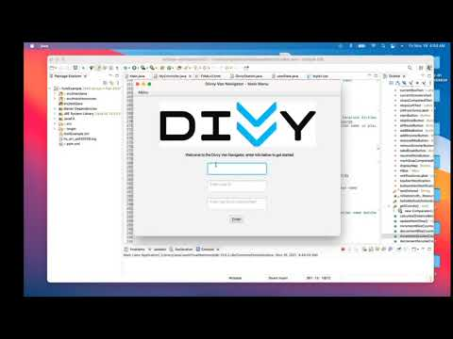
Video Demo - https://youtu.be/XJ0pfuvyU28

Slide 8
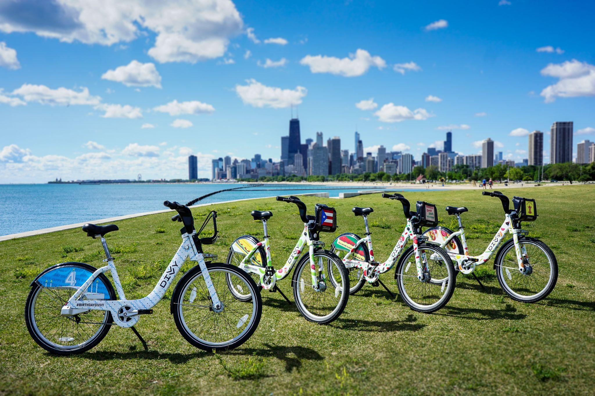
Thank you!

